Slide 1

Class 2

Slide 2

Welcome Again!

Slide 3


Today’s Schedule
Agenda:
Beginning of Class
Last Week Class Review
HW Pickouts
HW Review
Dive Deeper – Numericals and Text
Let’s Learn – Printing and Commenting
BREAK
Let’s Learn – Operators
Let’s Learn – Variables
Dive Deeper+
Practice Pickouts
HW Instructions
End of Class

Slide 4

Last Week – What did we learn?
Let’s discuss what we learnt last class.
Raise your hand to answer.

Slide 5


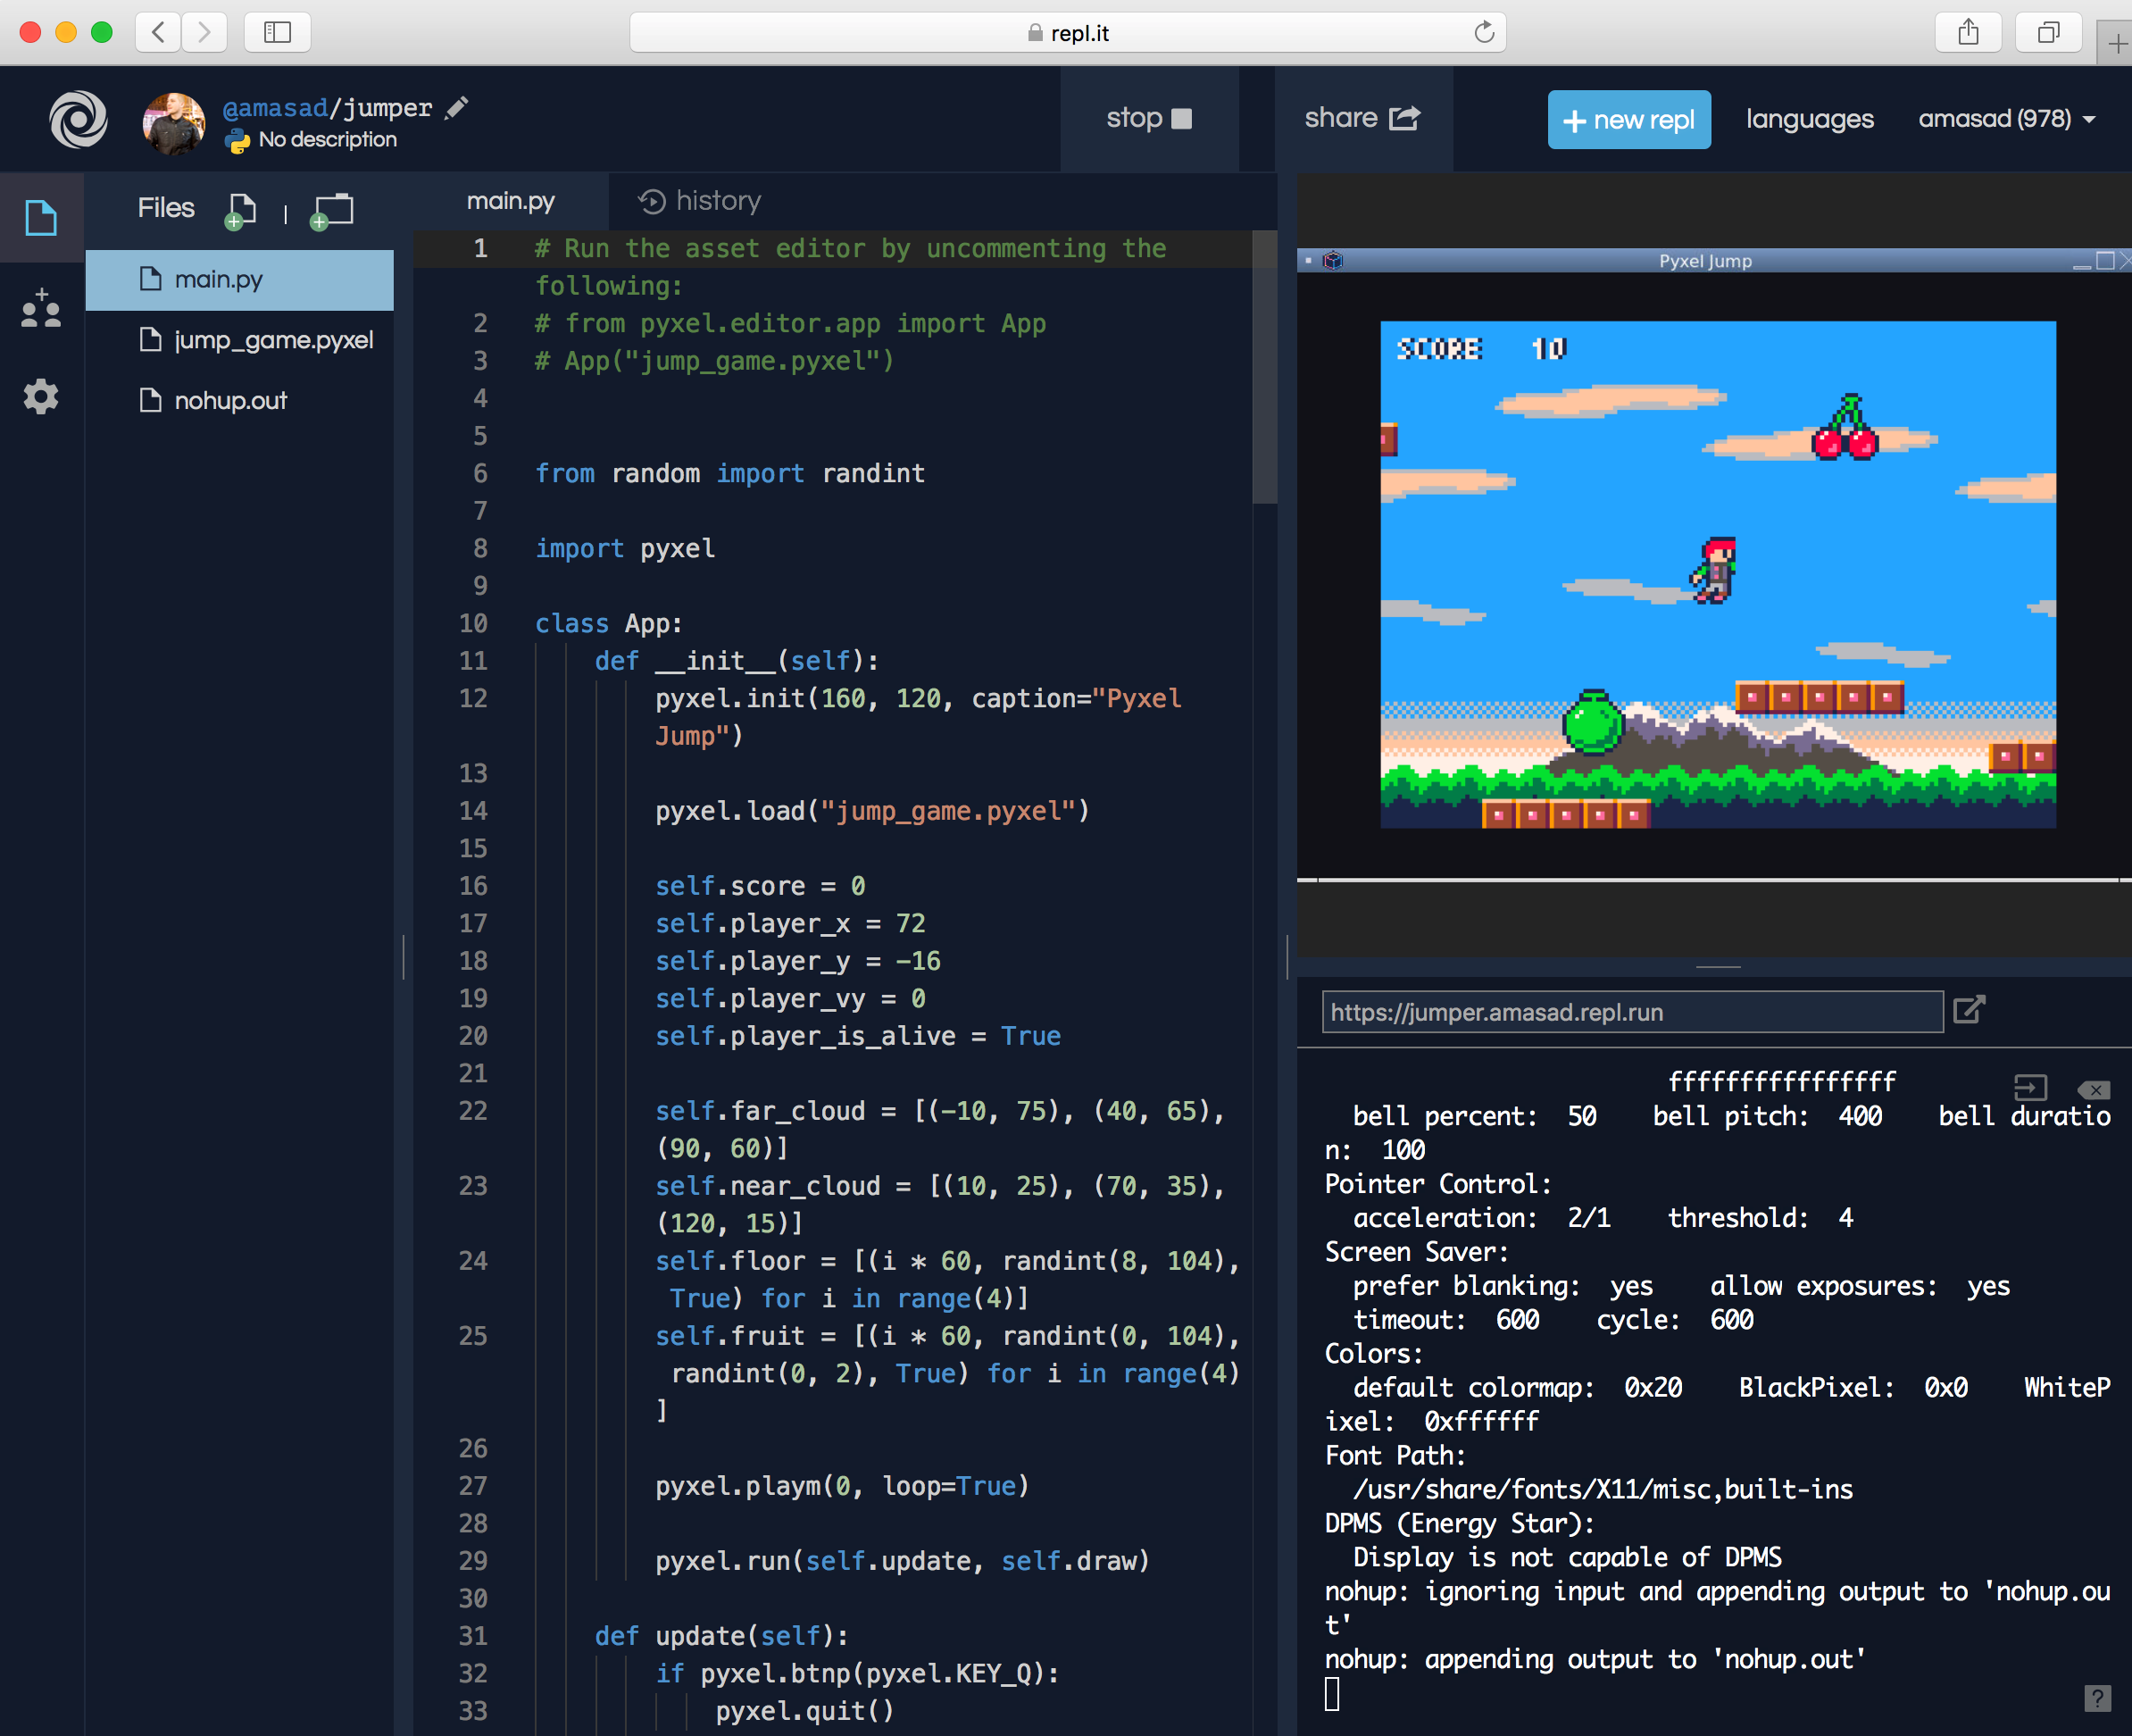
HW Pickouts
Pickouts are when I pick out people (or they volunteer), to share out something. HW Pickouts will be for those who want to volunteer to share their HW, and I will provide them brief corrections, and say what they did right and wrong. We will have 1 HW Pickout per day. Afterwards I shall open up my copy of what the HW should be in repl.it. If no-one volunteers, I shall pick on someone… so be ready!

Slide 6

HW Review
Let me open my copy of last week’s HW. We’ll briefly go over the content.
I will quickly give the answers to your questions and show you the program.

Slide 7

Dive Deeper (Text and Numericals)
Let’s dive a little deeper into Basic Text and Numericals.
These consist of String, Integer, and Float.
I’ll switch over to repl.it and we can learn a little more about it.
Follow along!

Slide 8


Printing and Commenting
Now you know a little bit more about Integers and Numericals. But you definitely don’t know enough. Let’s learn about printing, which will help us use datatypes like string and integer. We will also learn about commenting.
Let me open repl.it! We can learn them!
Let’s Learn – Printing and Commenting
Let’s Learn – Printing and Commenting

Slide 9

7 Minute Break!

Slide 10
Operators
Let’s now learn about operators, which will help us use datatypes like string and integer. There are 6 basic types.
Arithmetic operators
Assignment operators
Comparison operators
Logical operators
Identity operators
Membership operators
Let’s learn!
Let’s Learn – Printing and Commenting
Let’s Learn – Printing and Commenting

Slide 11
Variables
Now let’s learn about variables. These will help us store integers and string. It makes life easier in the field of python.
Variables are often found in algebraic equations, and multiple other coding languages.
There isn’t a definite set of categories for variables
This will probably be easier, once I open up repl.it.
Let’s go!
Let’s Learn – Printing and Commenting
Let’s Learn – Printing and Commenting

Slide 12
Dive Deeper+
Now here is something we do every class, a dive deeper plus. This is when we review everything we learnt in class as a whole and provide the connections. I explained every subject separately, right? But now let’s connect strings and integers with operators, variables, and printing.
Let’s go!

Slide 13
Practice Pickouts
This is just like HW Pickouts. But for practice. This time, it won’t be volunteers. I shall pick on a few of you, and you will answer some questions. Let’s start!

Slide 14

HW Info
Let me explain this week’s HW. I’ll go open it up!

Slide 15


Thanks for joining!

